Slide 1


LIFE FoundryTile: Valorisation of iron foundry sands and dust in the ceramic tile production process
(LIFE14 ENV/ES/000252)
Quereda Vázquez, Francisca¹; Clarens Blanco, Frederic²; Mesas Suárez, Mireia²
¹ Instituto de Tecnología Cerámica, Campus Universitario Riu Sec, Av. Vicent Sos Baynat s/n, 12006 Castellón, España
² Eurecat-Fundació CTM Centre Tecnològic, Plaça de la Ciència 2, 08243 Manresa, España

Slide 2


Slide 3
OBJECTIVES & SCOPE:
To demonstrate the valorization of all iron foundry sands and dust in the ceramic tile production process. The new application will have three main benefits: preservation of natural resources, increase foundry waste valorization and environmental footprint reduction

Slide 4
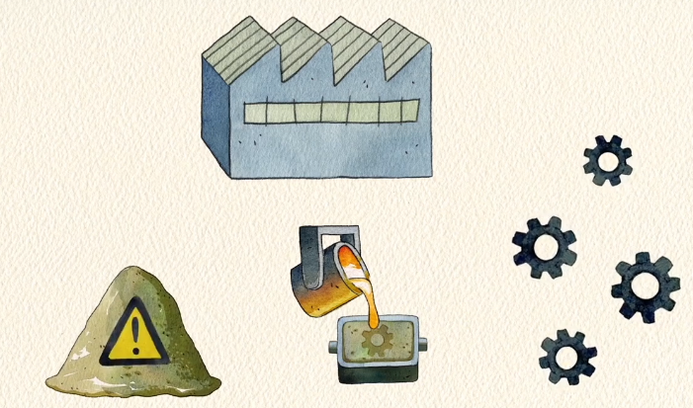
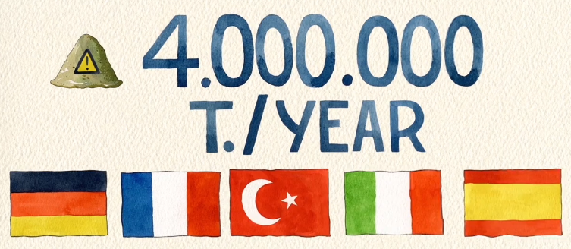
OBJECTIVES & SCOPE:

Slide 5
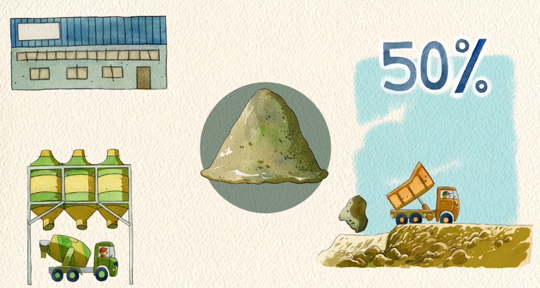
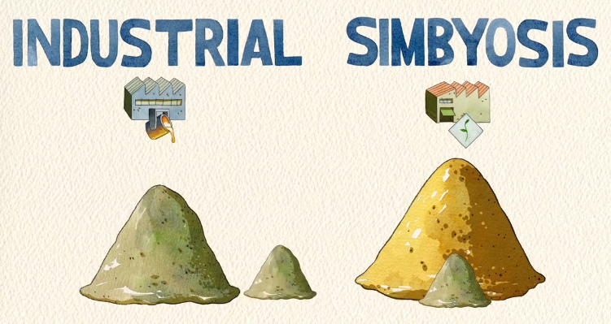
OBJECTIVES & SCOPE:

Slide 6
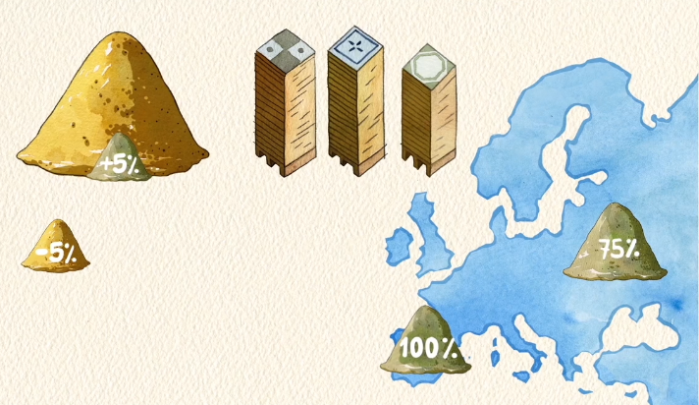
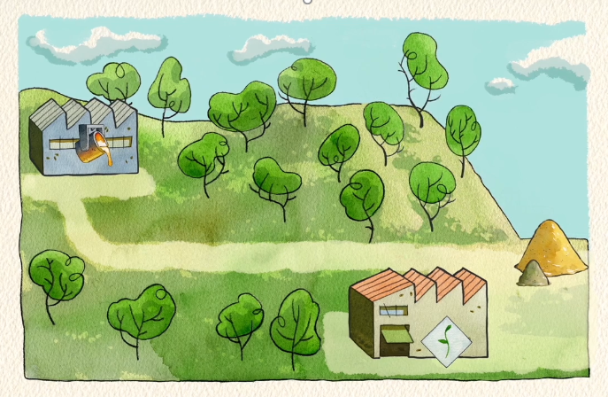
OBJECTIVES & SCOPE:

Slide 7
Approach to Industrial Symbiosis Strategy
Opportunity
Requirements
Adequacy
Test
Validation
Sustainable?
Implementation
Regulatory framework

Slide 8
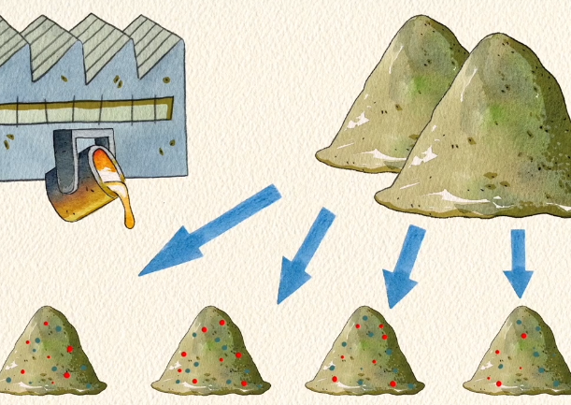
CLASIFICATION/ CHARACTERIZATION

Slide 9
CLASIFICATION/ CHARACTERIZATION
Clasification of foundry by-products:
      Sands (GS) and dusts (GD) from green moulding
      Sands (CS-) and dusts (CD-) from chemical moulding:
        FI: Phenol-isocyanate
        FU: Furanic
        FA: Phenol-alkaline
        SE: Silicate Ester
Clasification of ceramic tiles:
      Red firing wall tile
      Red firing stoneware tile
      White firing wall tile
      Porcelain tile
 | SiO₂ | Al₂O₃ | Fe₂O₃ | CaO | MgO | Na₂O | K₂O | Corg | LOI
GS | 89-95 | 2.5-3.0 | 0.7-0.8 | 0.3-0.5 | 0.4-0.6 | 0.4-0.5 | 0.1-0.3 | 0.8-3 | 1.7-5.1
GD | 66-72 | 6.5-8.5 | 2.0-2.1 | 1.4-1.7 | 1.1-2.0 | 0.9-1.5 | 0.3-1.2 | 10-14 | 14-18
CS | 92-95 | 0.4-13 | 0.4-4.5 | 0.0-2.5 | <0.1-18 | 0.2-1.0 | 0.1-1.0 | 0.1-2.5 | 0.4-4.1
CD | 25-94 | 0.9-21 | 0.4-5.5 | 0.1-3.5 | <0.1-22 | 0.1-9.0 | 0.3-2.3 | 0.1-40 | 0.4-54

Slide 10
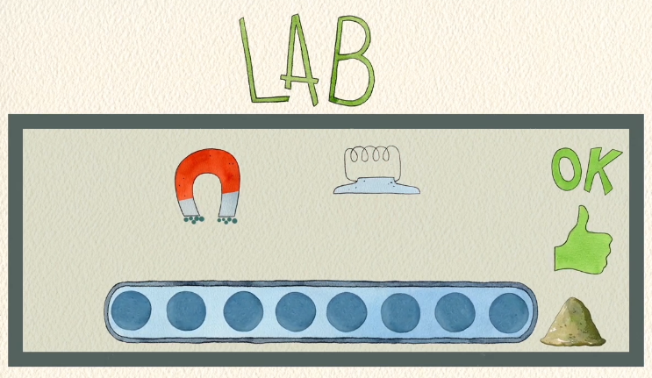
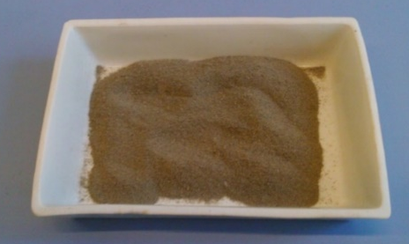
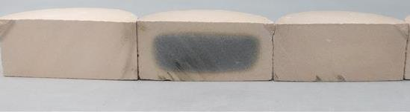
Treatments to increase valorisation potential:
Physical separation by sieving
      Organic carbon reduction does not meet the requirements of ceramic tiles
Thermal pre-treatment (600ºC)
 | Corg Initial (%) | Corg Final (%)
GD-2 | 14 | 0.24
CD-FI-2 | 14.5 | 0.84
CD-FU-1 | 8 | 0.02
CD-FA-2 | 32.7 | 0.07
STD
S
S-T
  Magnetic separation
      Not necessary: limiting factor is Organic carbon

Slide 11
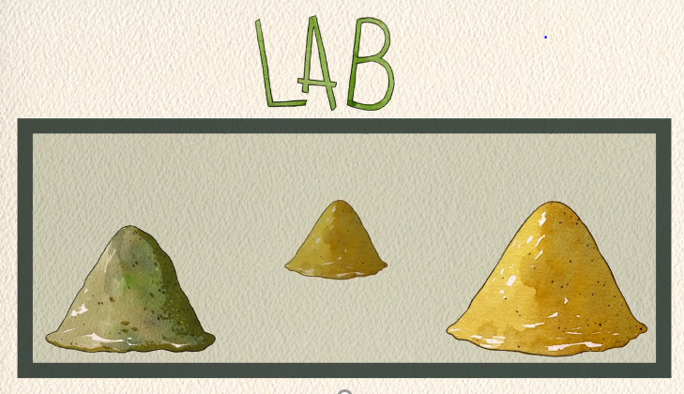
Valorisation options
Option | Valorised by-products (Tn) | Valorised by-products (%) | Ceramic tile production used (Tn) | Ceramic tile production used (%)
1: Maximum amount valorised | 121 600 | 59* | 3 947 000 | 45
2: Valorisation of all chemical moulding by-products | 36 825 | 100** | 2 250 442 | 26
3: Valorisation of all chemical moulding by-products and part of green moulding by-products | 140 336 | 100**+61*** | 8 740 000 | 100
4: Valorisation of all chemical moulding by-products and green moulding dusts and part of green moulding sands | 189 950 | 100**+90*** | 8 740 000 | 100
* Only sands, 0% dusts
** Respect to chemical moulding by-products
*** Respect to green moulding by-products

Slide 12
Valorisation options
CODE | Total landfilled (tn) | Ratio (%) | Option 1 (%) | Option 2 (%) | Option 3 (%) | Option 4 (%)
GS | 147425 | 71.0 | 84.0 | 0.0 | 63.6 | 77.6
GD | 23494 | 11.3 | 0.0 | 0.0 | 10.1 | 3.0
CS-FI | 9362 | 4.5 | 5.3 | 25.4 | 6.7 | 4.9
CD-FI | 681 | 0.3 | 0.0 | 1.8 | 0.5 | 0.4
CS-FU | 9669 | 4.7 | 5.5 | 26.3 | 6.9 | 5.1
CD-FU | 6273 | 3.0 | 0.0 | 17.0 | 4.5 | 3.3
CS-FA | 4440 | 2.1 | 2.5 | 12.1 | 3.2 | 2.3
CD-FA | 1883 | 0.9 | 0.0 | 5.1 | 1.3 | 1.0
CS-SE | 4491 | 2.2 | 2.6 | 12.2 | 3.2 | 2.4
CD-SE | 26 | 0.013 | 0.015 | 0.071 | 0.019 | 0.014
Organic carbon (%) |  | 3.29 | 1.77 | 3.21 | 3.28 | 2.45
Percentage in the ceramic body |  |  | 3.0 | 1.6 | 1.6 | 2.2

Slide 13
Laboratory tests:
Composition | RF-STD | RF-1.6% | RF-2.2% | RF-3% | RF-CM 1.6%
Bulk Density (g/cm³) | 2.305 | 2.281 | 2.261 | 2.262 | 2.272
Linear Shrinkage (%) | 5.3 | 5.1 | 5.0 | 5.0 | 5.0
Water Absorption (%) | 5.2 | 5.7 | 6.1 | 6.1 | 5.8
L.O.I. (%) | 4.92 | 4.81 | 4.89 | 4.62 | 4.62
Mechanical strength (kg/cm²) | 400 | - | 350 | - | -
Thermal expansion at 700ºC (‰) | 6.1 | - | 6.1 | - | -
Index of pyroplasticity (cm⁻¹x10⁵) | 3.2 | - | 2.8 | - | -

Slide 14
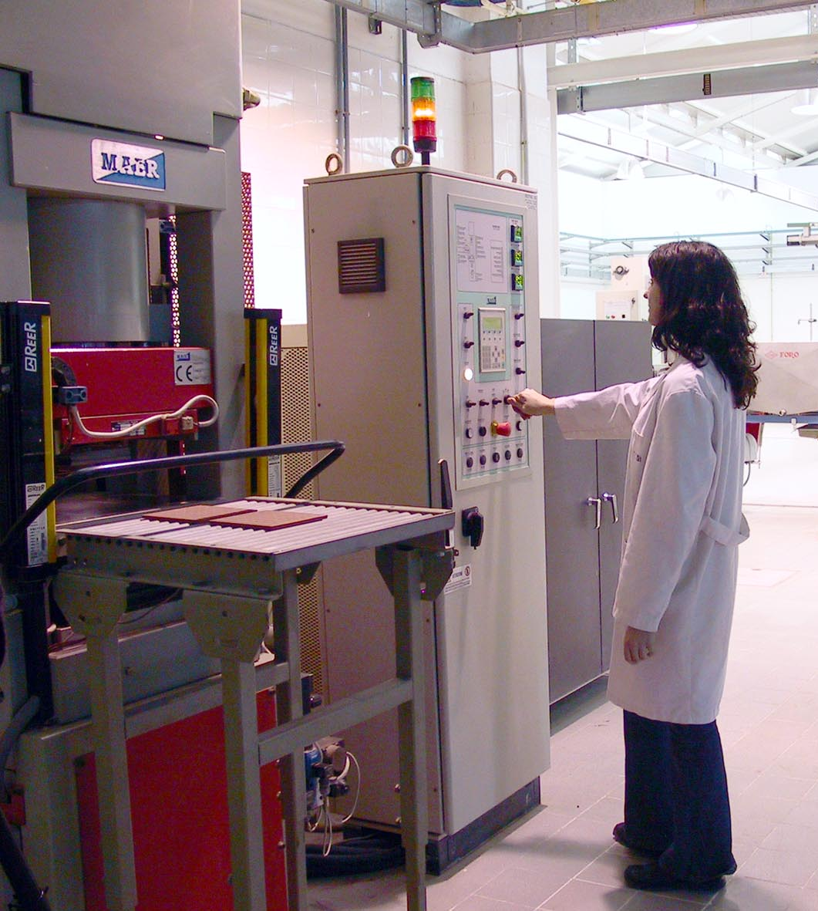
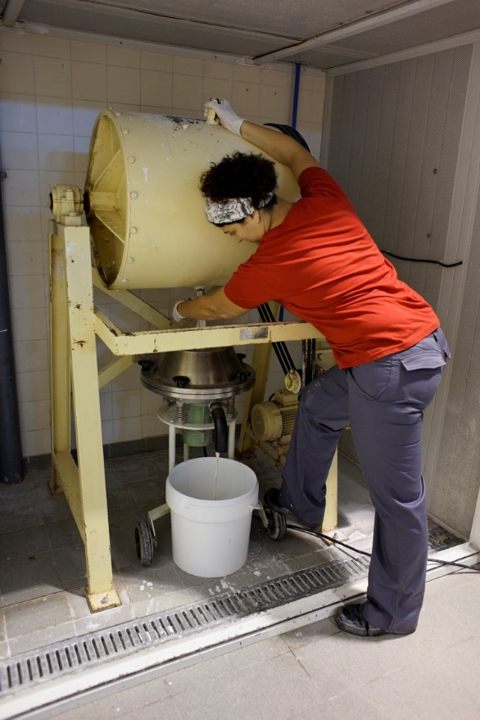
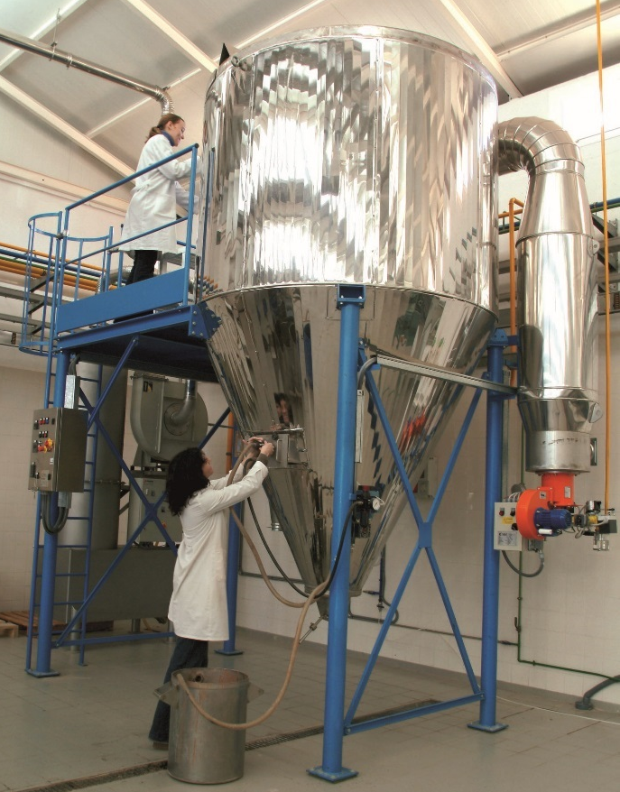
Pilot scale tests for red bodies (ITC-AICE):

Slide 15
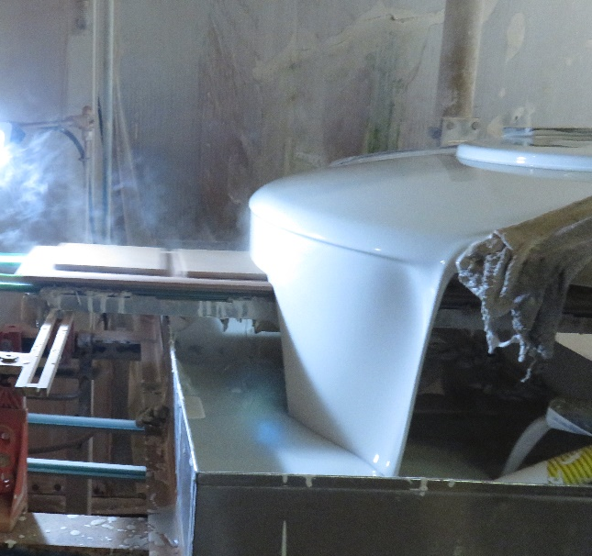
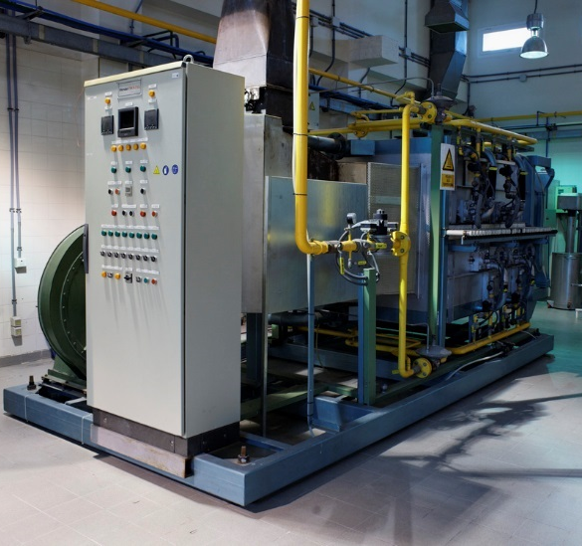
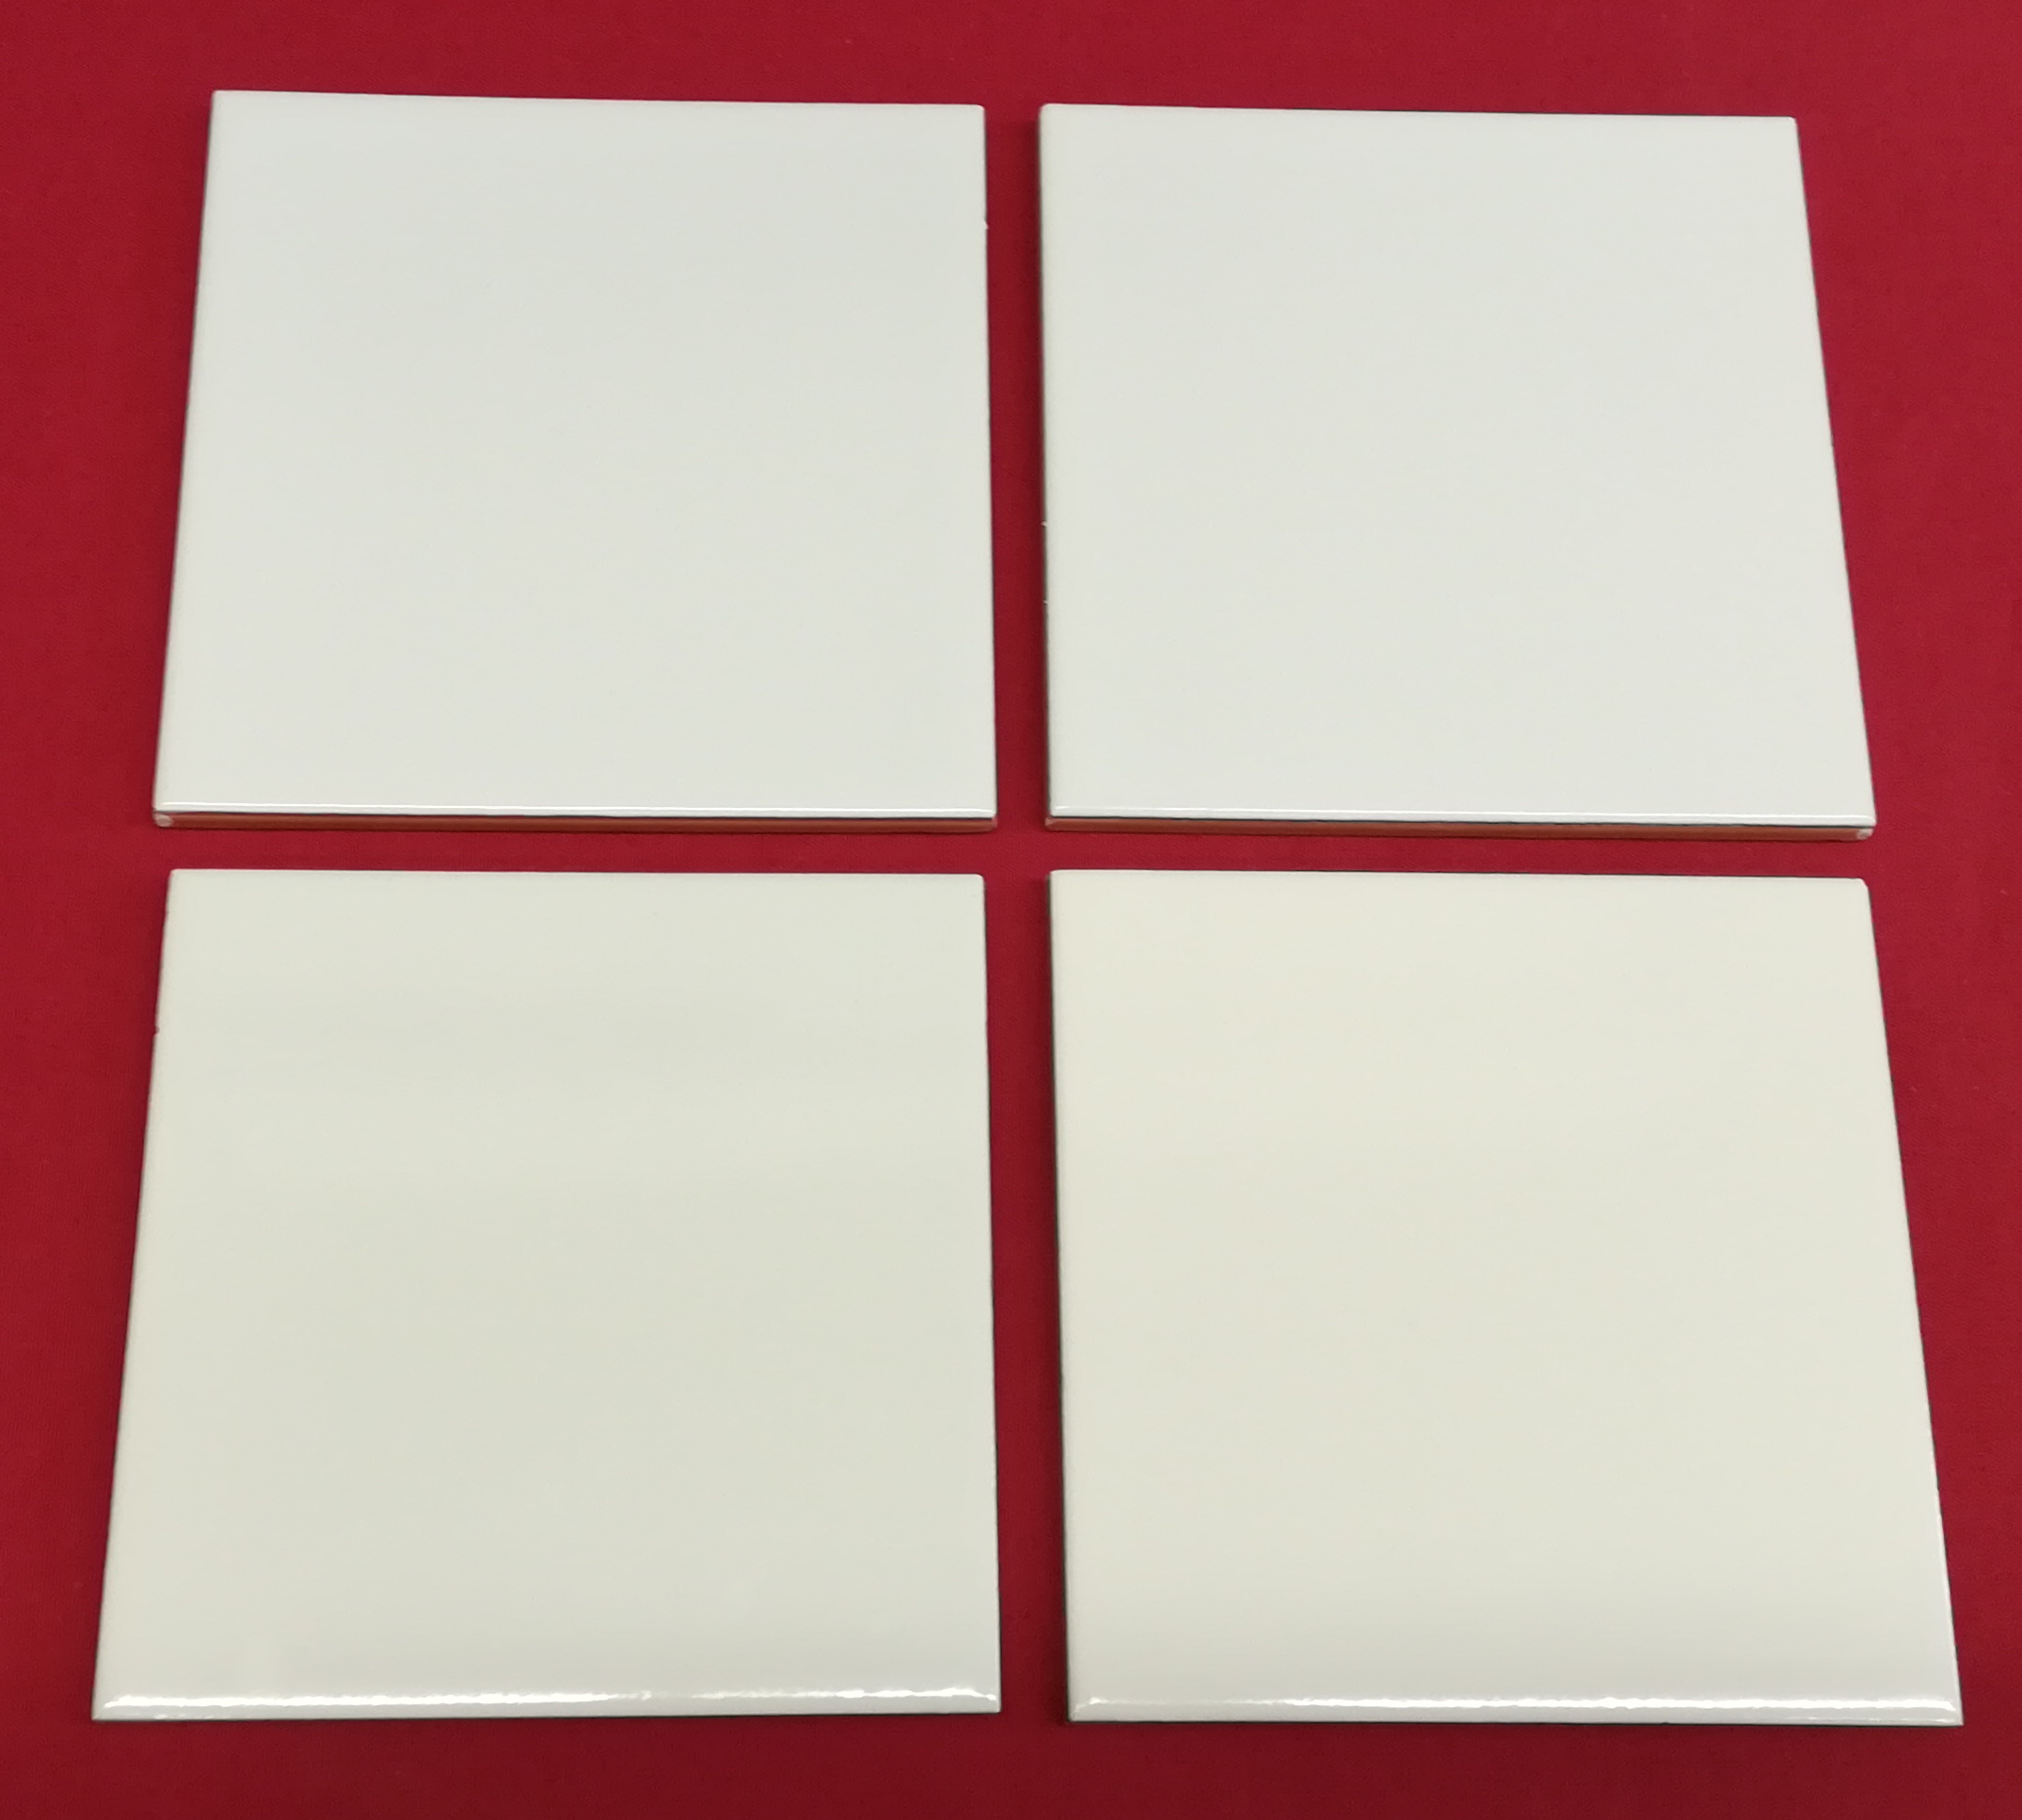
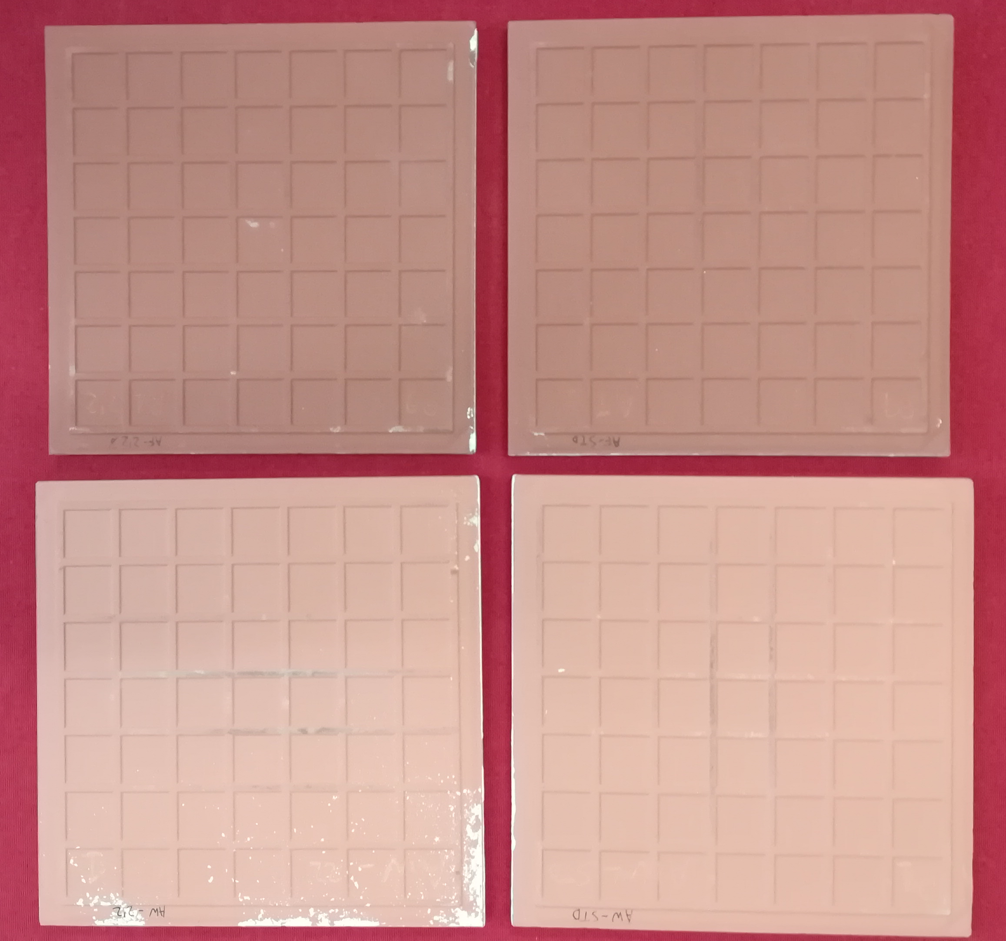
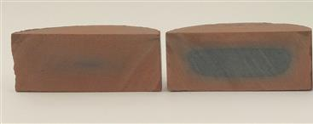
Pilot scale tests for red bodies (ITC-AICE):
AF-STD
AF-2.2%

Slide 16
Evolved gas analysis tests

Slide 17
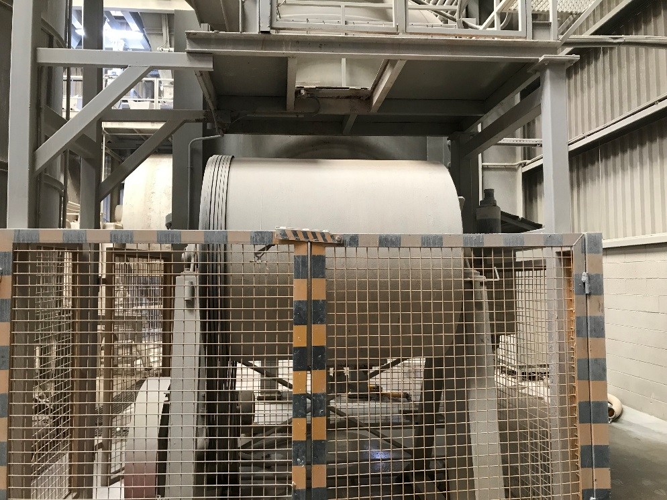
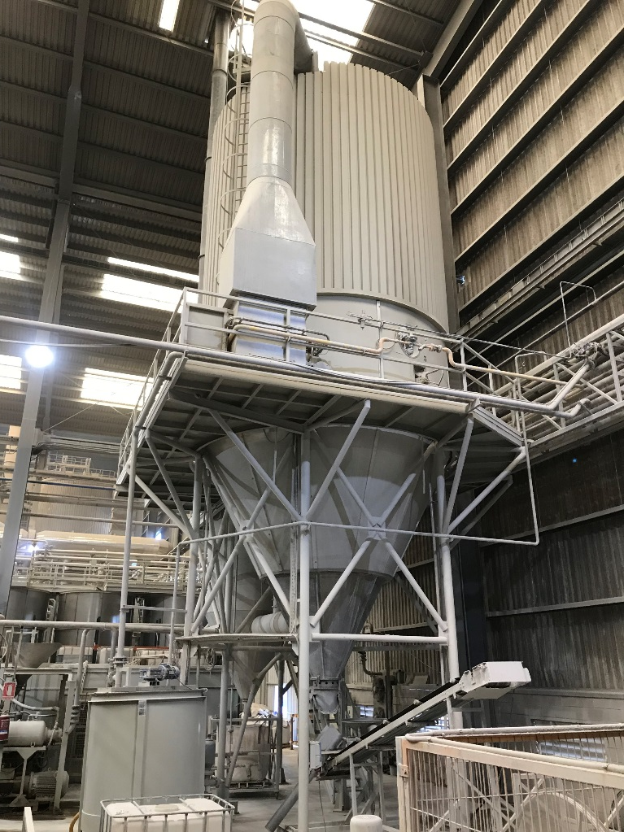
Pilot scale tests for white bodies (EUROATOMIZADO):

Slide 18
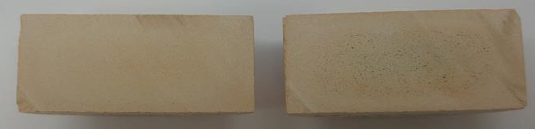
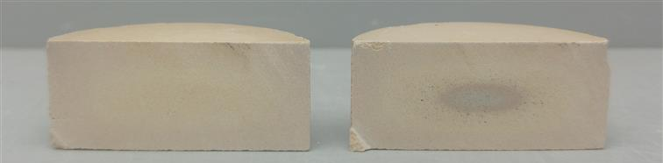
Pilot scale tests for white bodies (EUROATOMIZADO):
Composition | P-STD | P-1%
Temperature (ºC) | 1194 | 1191
Bulk Density (g/cm³) | 2.406 | 2.402
Linear Shrinkage (%) | 7.1 | 7.0
L.O.I. (%) | 4.06 | 4.03
Mechanical strength (kg/cm²) | 620 | 600
Thermal expansion at 700ºC (‰) | 5.4 | 5.4
Index of pyroplasticity (cm⁻¹x10⁵) | 3.5 | 3.4
L* | 65.2 | 64.6
a* | 2.8 | 2.8
b* | 13.2 | 12.9
WW-STD
WW-2,2%
P-STD
P-1%

Slide 19
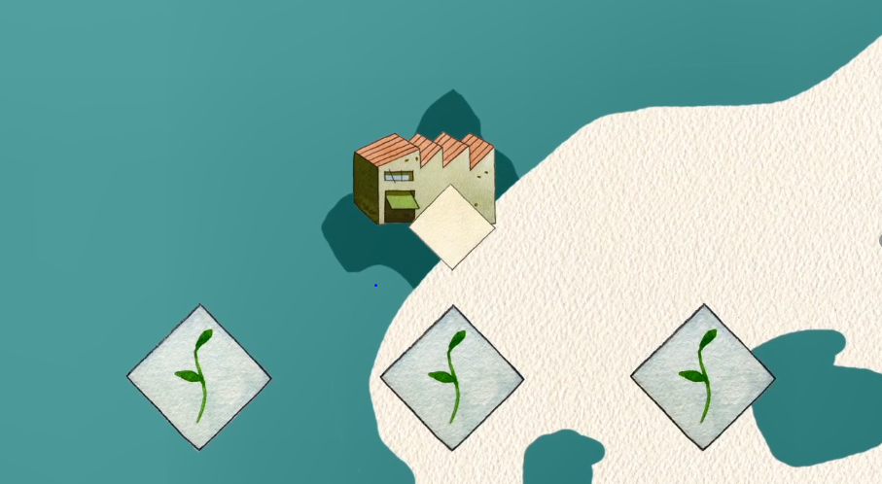
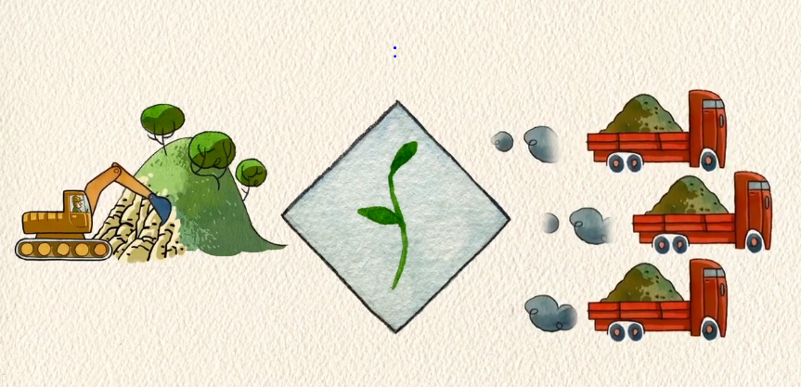



Industrial trials
Raw materials, foundry by-products and water
Milling
Spray-drying
Glaze
Preparation
Pressing
Drying
Glazing
Firing
Ceramic Tile

Slide 20
Industrial trials
Results:
  Preparation of 20 tonnes of each type of product: around 800 m² of wall tiles and porcelain tiles.
  Longer firing cycles (around 15%) had to be implemented for the elimination of black core
  Gaseous emissions during firing where checked. The introduction of foundry by-products does not produce significant changes on the emissions of particles or gases.
  The tiles produced exceed the technical requirements set by the European ceramic tile regulations.

Slide 21
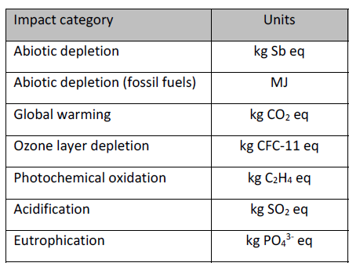
Life Cycle Assessment (LCA)
Evaluated scenario: Porcelain tile with foundry by-products vs conventional porcelain tile
SCENARIO 1
Realistic approach
SCENARIO 3
SCENARIO 2
Efficient logistics
Transport by ship
Conservative approach
Inefficient logistics
CONVENTIONAL

Slide 22
Life Cycle Assessment (LCA)
Maximum transport distance (where Foundrytile solution is environmentally positive):
PRODUCT | Maximum transport distance (km)
White firing wall tile | 877
Porcelain tile | 876
Red firing floor tile | 1024
Red firing wall tile | 921
Economic feasibility
Product | FOUNDRYTILE (€/m²) | CONVENTIONAL (€/m²) | Difference (€/m²)
White firing wall tile | 9,12 | 9,21 | 0,09
Porcelain tile | 9,51 | 9,55 | 0,04
Red firing floor tile | 9,20 | 9,25 | 0,05
Red firing wall tile | 9,17 | 9,23 | 0,07

Slide 23
Human Health Risk Assessment (HHRA)
Evaluated scenarios:
Scenario |  | Receptor | Ingestion | Inhalation of particles | Inhalation of volatiles | Dermal contact
1A | Manufacturing process of the wet paste | Worker | X | X | X
1B | Ceramic tiles manufacturing process |  | X |  | X
2 | Cutting and laying of ceramic tiles |  | X | X | X | X

Slide 24
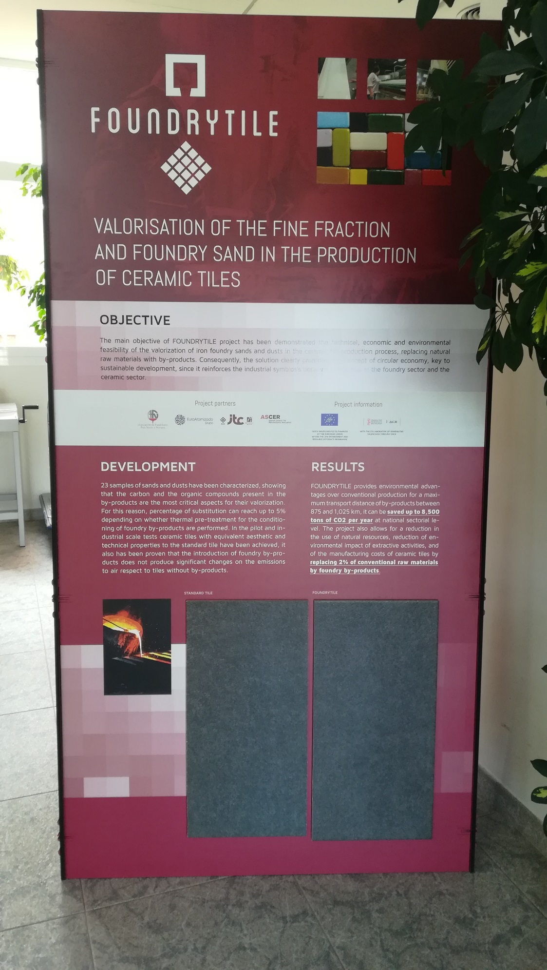

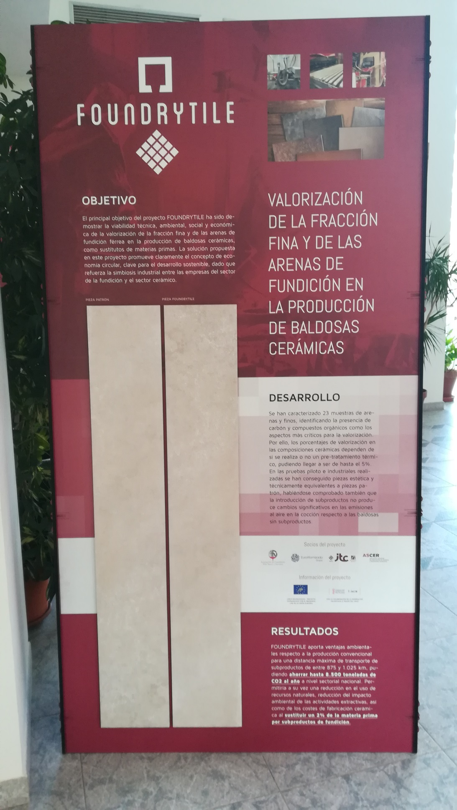





Slide 25


Acknowledgements
ACKNOWLEDGEMENTS
We would like to thank the 17 companies that have provided data and samples

Slide 26
Thanks for your attention
paqui.quereda@itc.uji.es
www.foundrytile.eu

